Slide 1
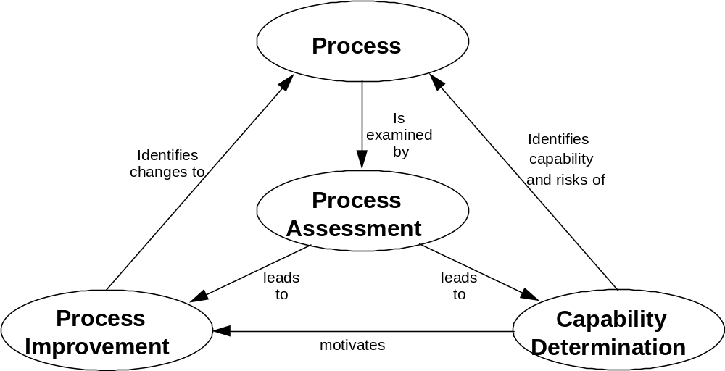

ISO TR 15504 (SPICE) Philosophy*
CMMI and SPICE
Focus
of CMMI
Focus
of SPICE
Use of SPICE
by HIS
HIS = Hersteller Initiative Software
DC, BMW, VW, Audi, Porsche
* Source: ISO TR 15504, Part 1
Department | 8/1/2007 | © Robert Bosch GmbH 2007. All rights reserved, also regarding any disposal, exploitation, reproduction, editing, distribution, as well as in the event of applications for industrial property rights.

Slide 2
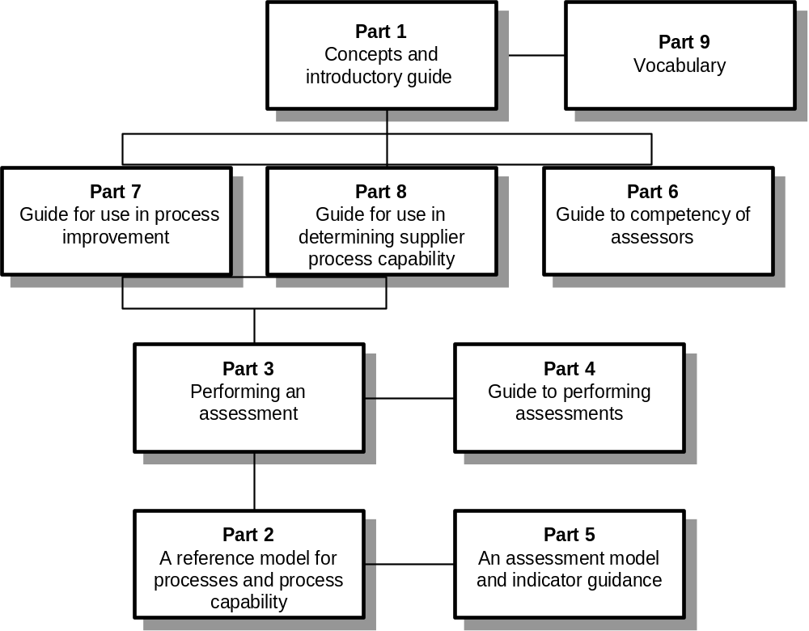
ISO TR 15504 (SPICE) Components *
CMMI and SPICE
HIS applies part 5 for project focussed supplier assessments
HIS Hersteller Initiative Software
* Source: ISO TR 15504, Part 1
Department | 8/1/2007 | © Robert Bosch GmbH 2007. All rights reserved, also regarding any disposal, exploitation, reproduction, editing, distribution, as well as in the event of applications for industrial property rights.

Slide 3
CMMI versus SPICE
CMMI and SPICE
Guidance for developing and improving engineering processes
Defines essential elements for effective engineering processes
Addresses the use of a proven approach to achieve organizational maturity
Framework for assessing software processes
Defines high level, essential activities for software engineering
Addresses the use of process assessments for process improvement and process capability determination
Department | 8/1/2007 | © Robert Bosch GmbH 2007. All rights reserved, also regarding any disposal, exploitation, reproduction, editing, distribution, as well as in the event of applications for industrial property rights.

